Slide 1
CROP PRODUCTION DATA ANALYSIS
SUBMITTED BY:
T.DATTATREYA
NIT JAIPUR

Slide 2
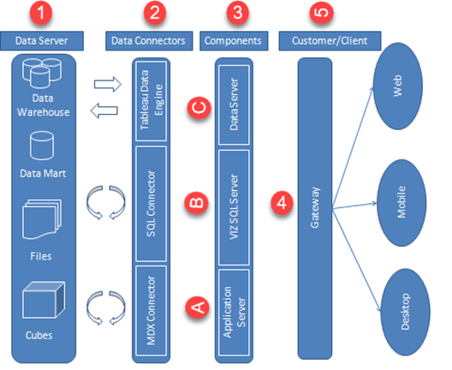
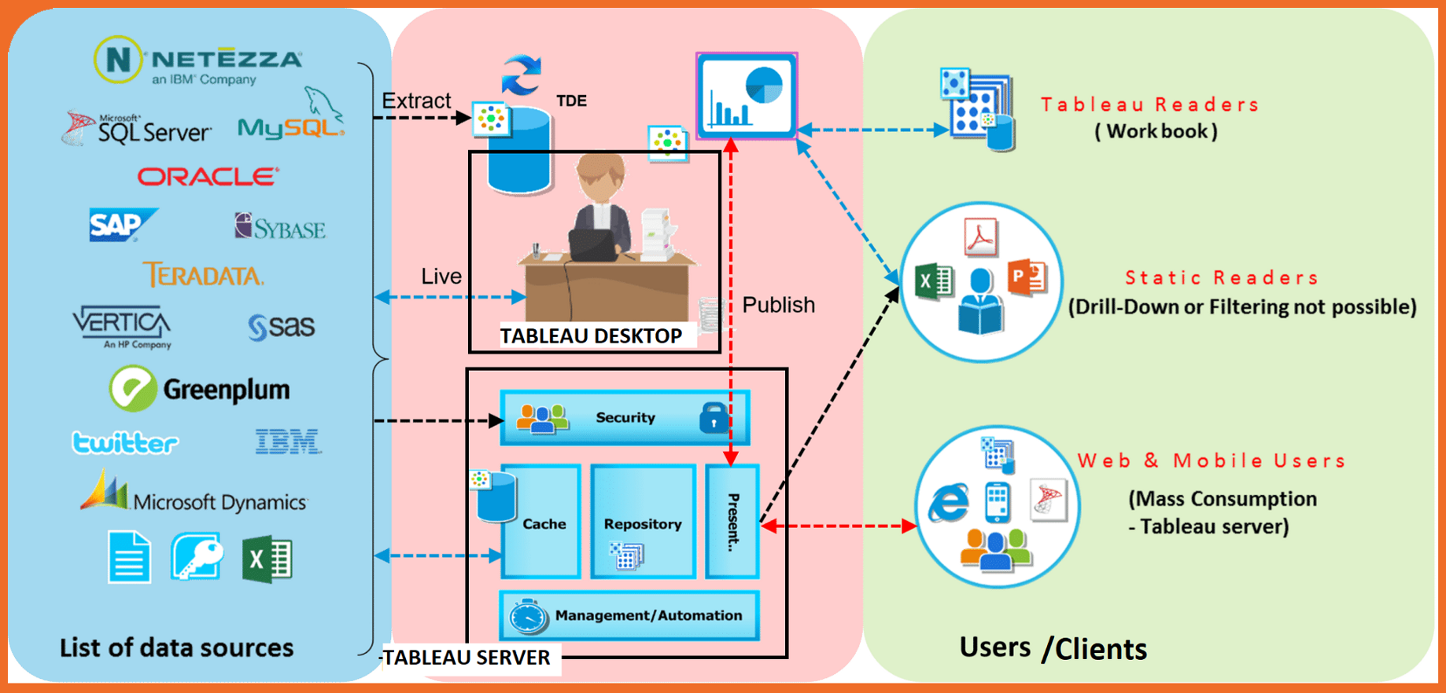
ARCHITECTURE

Slide 3
ETL OPERATIONS
Data is collected from the given dataset.
Imported the data to a dataframe using Pandas library in Python
Transformed the Data by replacing null values using the mean & median of the crop production category.
After the data manipulation and transformation the data is saved as .csv format and imported to Tableau for further analysis.
Data types of certain columns had been changed according to requirement in Tableau.

Slide 4
PAGES IN THE REPORT PUBLISHED
Production Overview
Year vs Production
Year vs Production Forecasted
Year vs Area
Year vs Area Forecasted
Map Overview
Crop Overview India
Production Share
Crop Share
Season Wise Analysis Crop Production
Area Racing Bar Chart
Production Racing Bar Chart
Crops Treemap

Slide 5
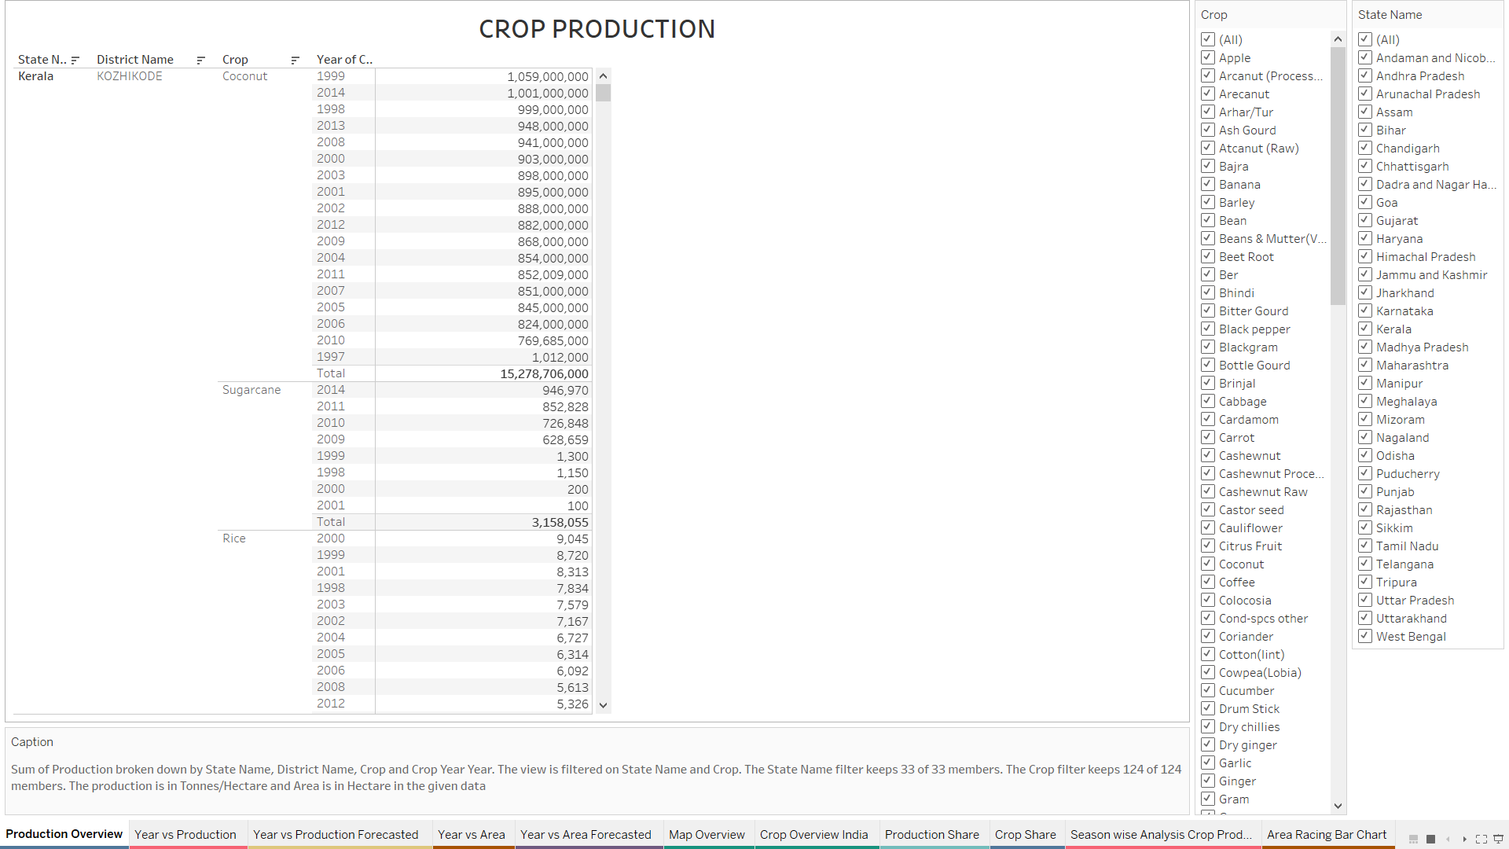
PRODUCTION OVERVIEW
The top States in Crop Production in terms of tonnes are:
Kerala
Andhra Pradesh
Tamil Nadu
Uttar Pradesh
Chhattisgarh
Assam
West Bengal
Maharashtra
The top Crops in these states are
Coconut, Sugarcane, Rice, Potato, Banana, Jowar, Mango, Cotton, Maize, Groundnut, Dry Chillies.

Slide 6
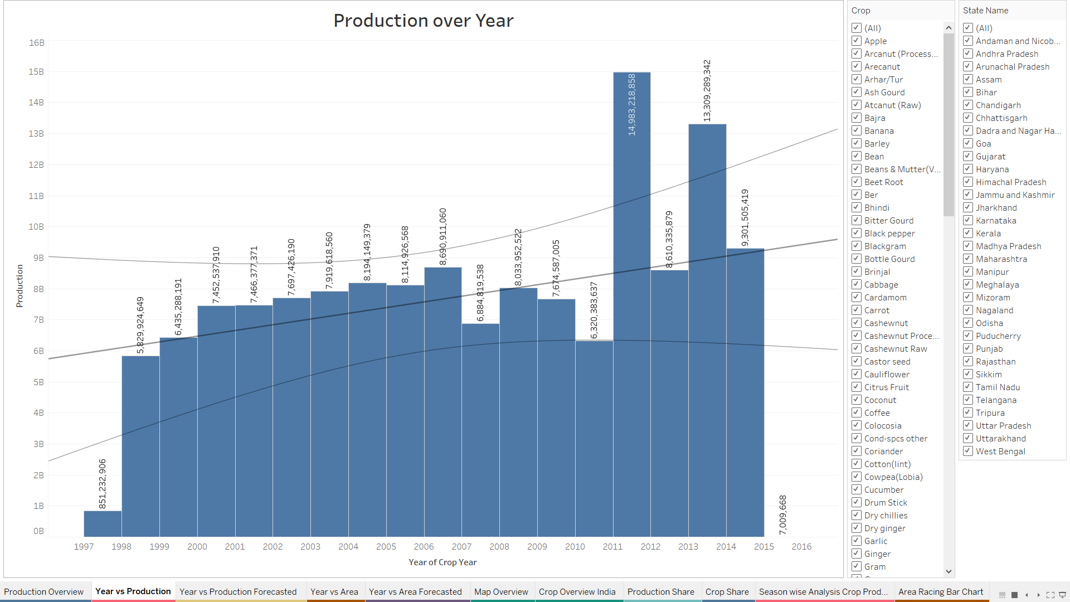
YEAR VS PRODUCTION
The plot shown besides is between Year vs Production.
The filters beside show the crop categories and States
We can see a linear trend as shown in the bar graph. There is sudden surge in the Production in between 2010 and 2011 it may be due to
Increase in Population.
Increase in Demand.
Increase in demand from Foreign Countries.
Technological advancements in Agriculture Sector.

Slide 7
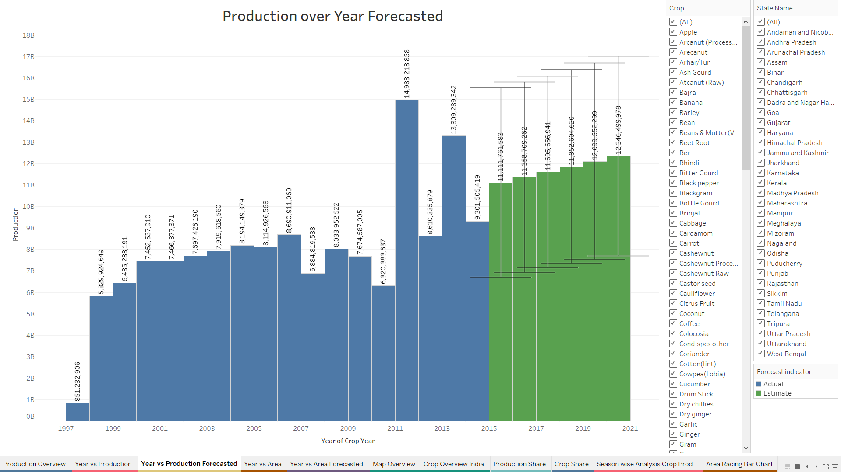
YEAR VS PRODUCTION FORECASTED
From the bar chart we can see as there is a linear trend. The Forecasted production for the succeeding years have increasing production rate and the numbers indicate it.
The Forecasted model is an Automatic Model by the Tableau software for 6 years with 95% Confidence level.

Slide 8
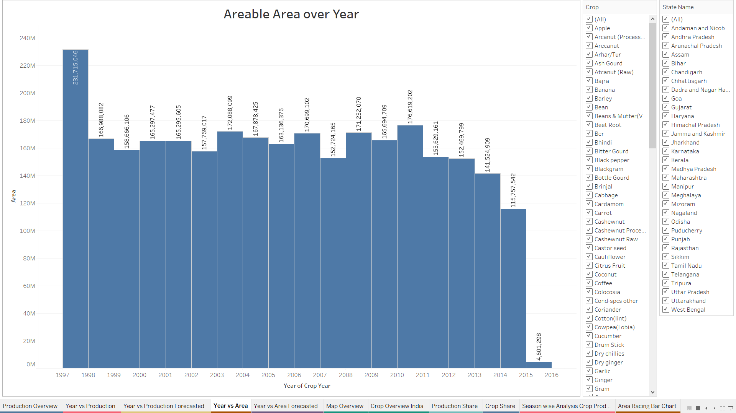
YEAR VS AREA
The Arable Land bar chart is plotted in the figure.
From the past 10 years the arable land is almost same it may be due to:
Due to increasing population, Technological advancements people are migrating to Urban Areas.
Increasing use of fertilizers to get maximum crop production within the limited agricultural land.

Slide 9
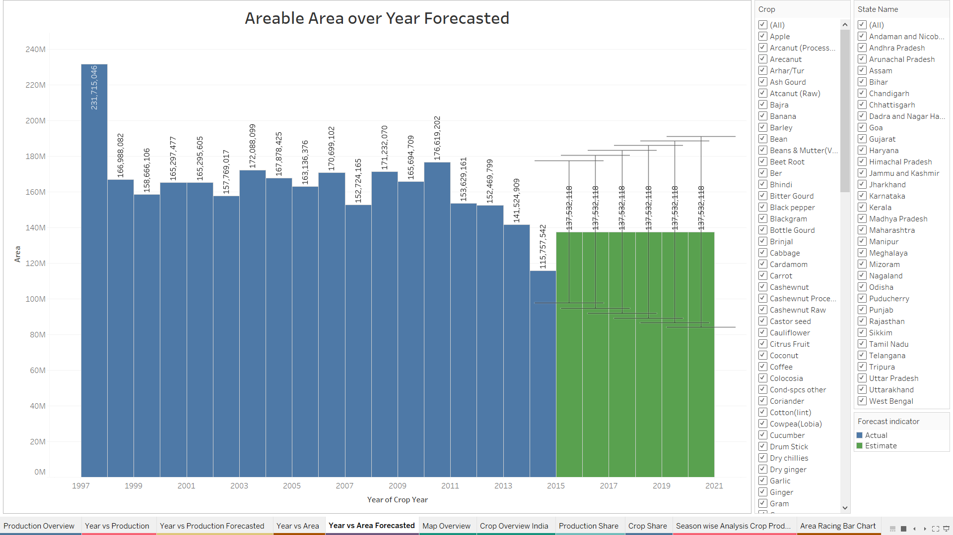
YEAR VS AREA FORECASTED
From the bar chart we can see as there is a constant trend going on in the Arable Land.
The Forecasted model is an Automatic Model by the Tableau software for 6 years with 95% Confidence level.
The Forecasted plots also indicates the same pattern that a constant trend for the next 6 succeeding years
There are also some limits with respect to the predicted values.

Slide 10
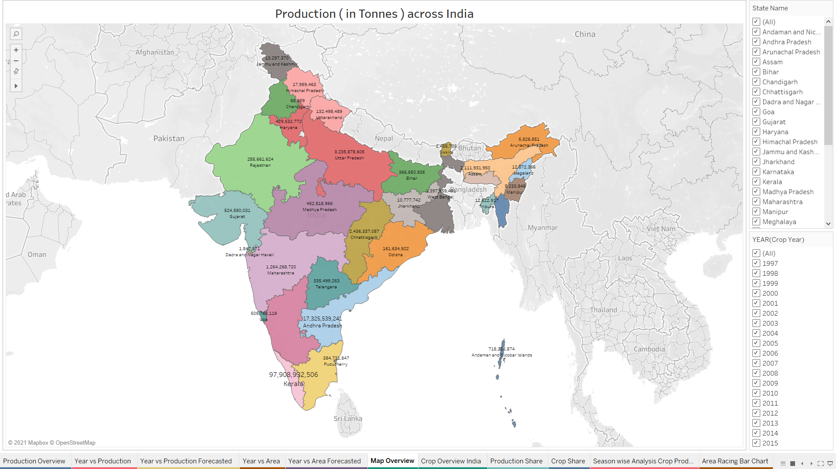
MAP OVERVIEW
The map indicates the overall production across all the states in India.
Kerala has highest crop production capacity followed by Andhra Pradesh, Tamil Nadu, Uttar Pradesh, Madhya Pradesh.
Each State is famous for its growing conditions to specific crops, particularly Kerala for Coconut, Andhra Pradesh for Coconut & Sugarcane etc.

Slide 11
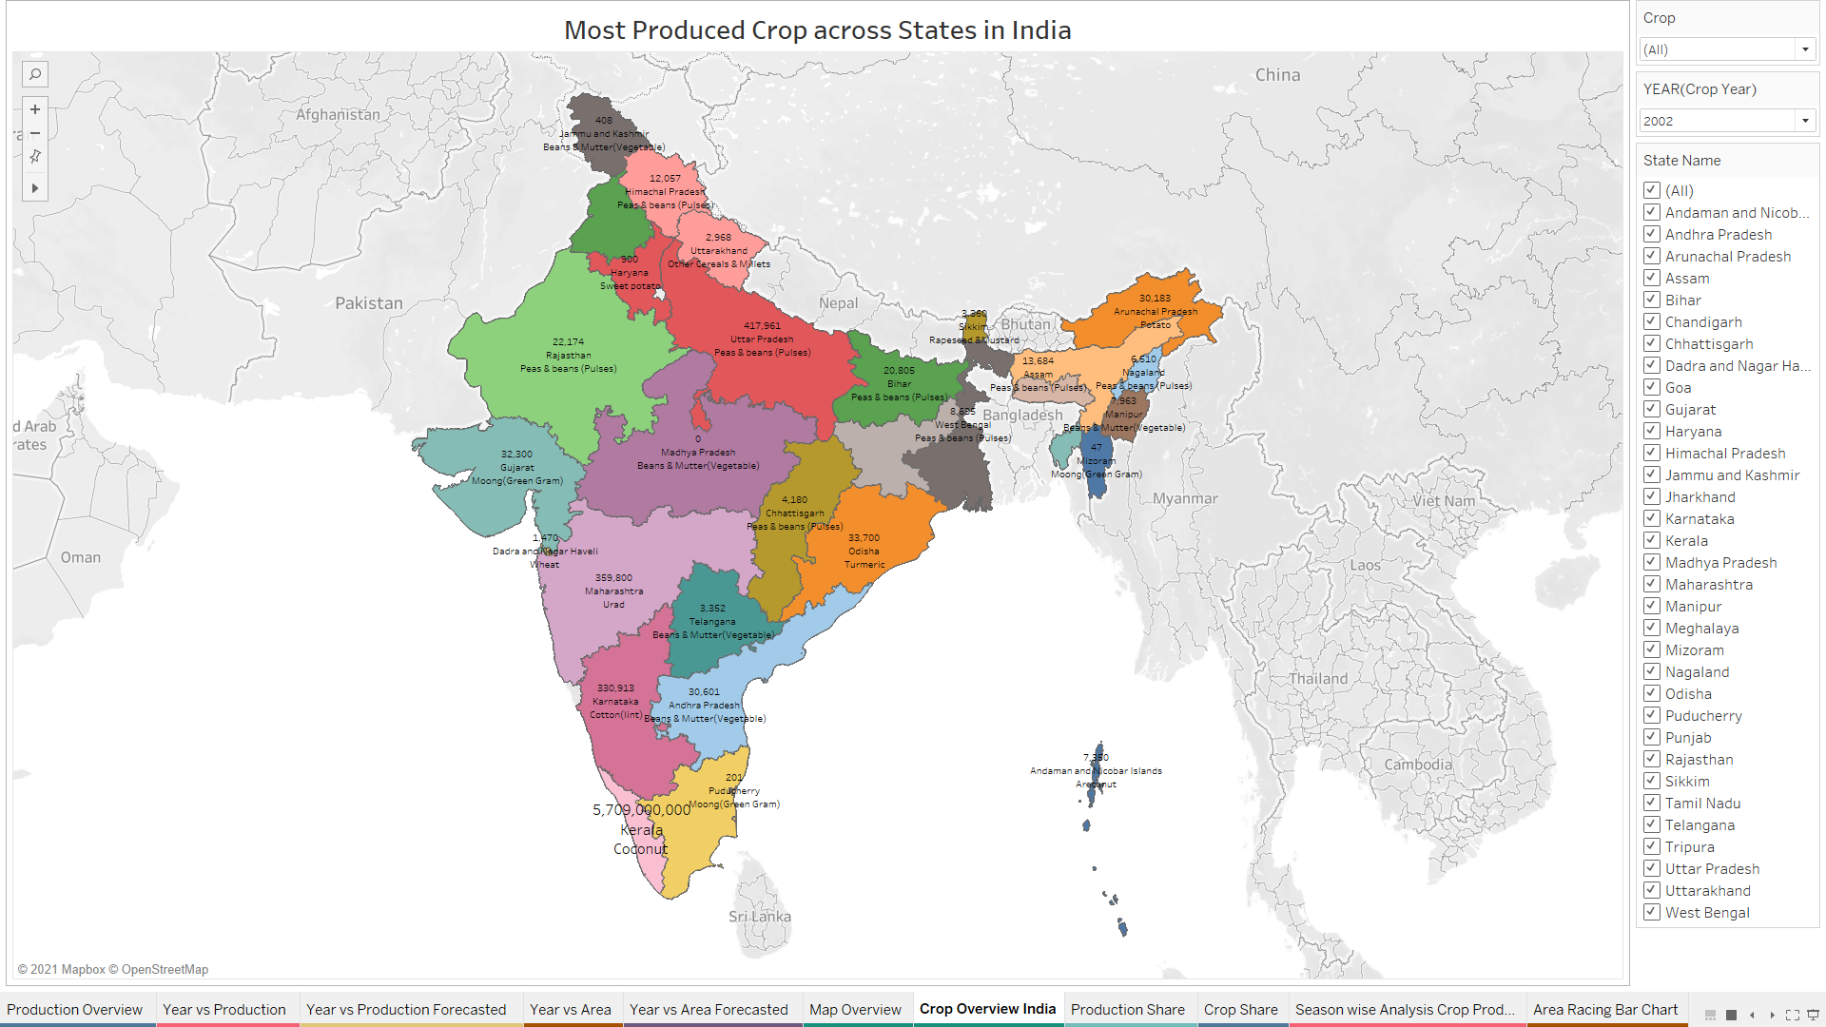
CROP OVERVIEW INDIA
The map indicates the states with their highest crop production.
Kerala has highest crop production capacity followed by Andhra Pradesh, Tamil Nadu, Uttar Pradesh, Madhya Pradesh.
Each State is famous for its growing conditions to specific crops, particularly Kerala for Coconut, Andhra Pradesh for Coconut & Sugarcane etc.
Beans & Mutter are mostly grown in Andhra Pradesh, Telangana, Madhya Pradesh. Green Gram in Gujarat & Bajra in Uttar Pradesh.

Slide 12
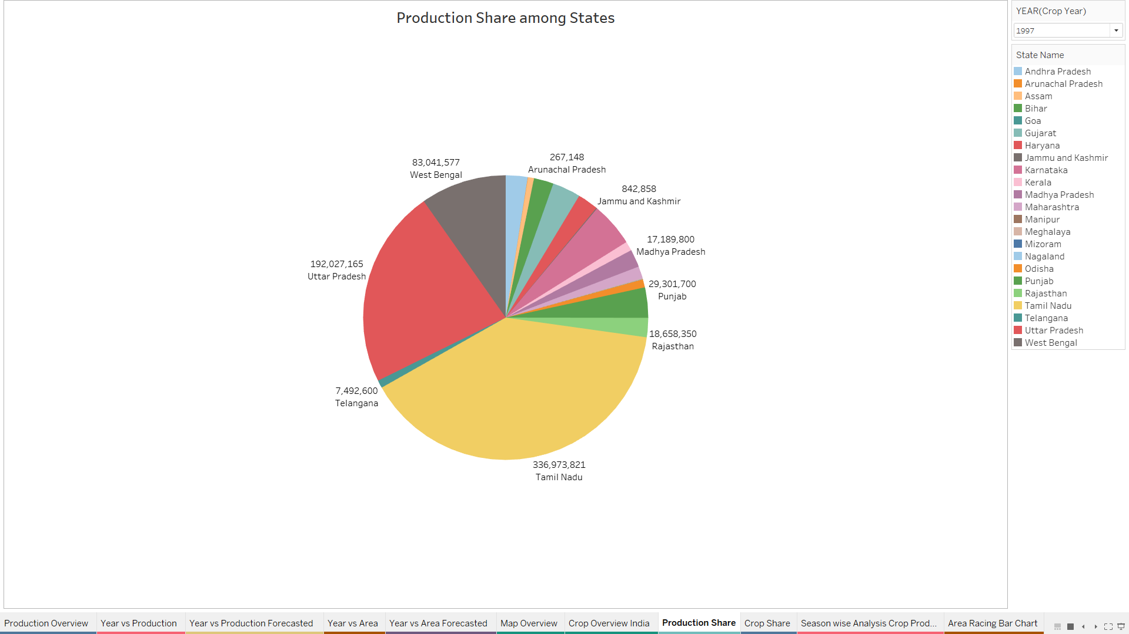
PRODUCTION SHARE
The Pie Chart indicates the states with their portion of crop production
We can change the year using filter to see the crop production capacity across states.
Every year there may be few ups and downs due to demand for a crop, based on the seasonal changes, high yield rate etc.

Slide 13
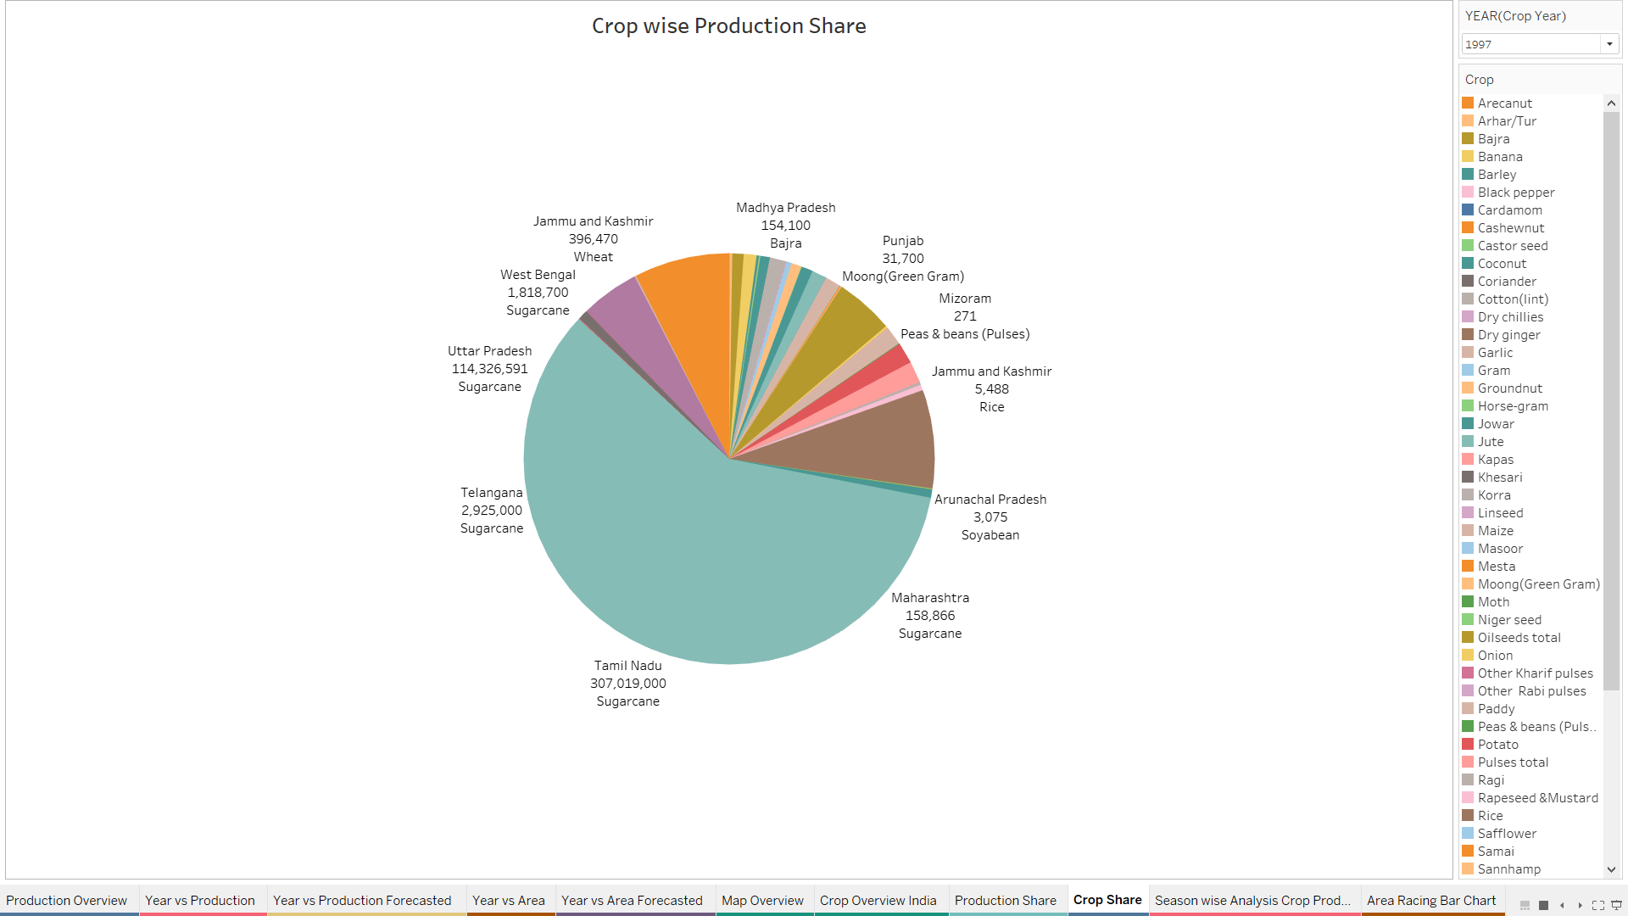
CROP SHARE
The Pie Chart indicates the states with their portion of each crop with highest production.
We can change the year using filter to see the crop production capacity across states.
Every year there may be few ups and downs due to demand for a crop, based on the seasonal changes, high yield rate etc.
From the Pie chart we can observe that in the year 1997 Sugarcane occupies a large portion coming from Tamil Nadu, Andhra Pradesh, Maharashtra, Telangana.

Slide 14
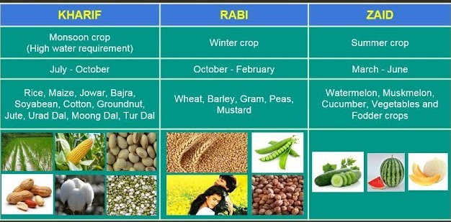
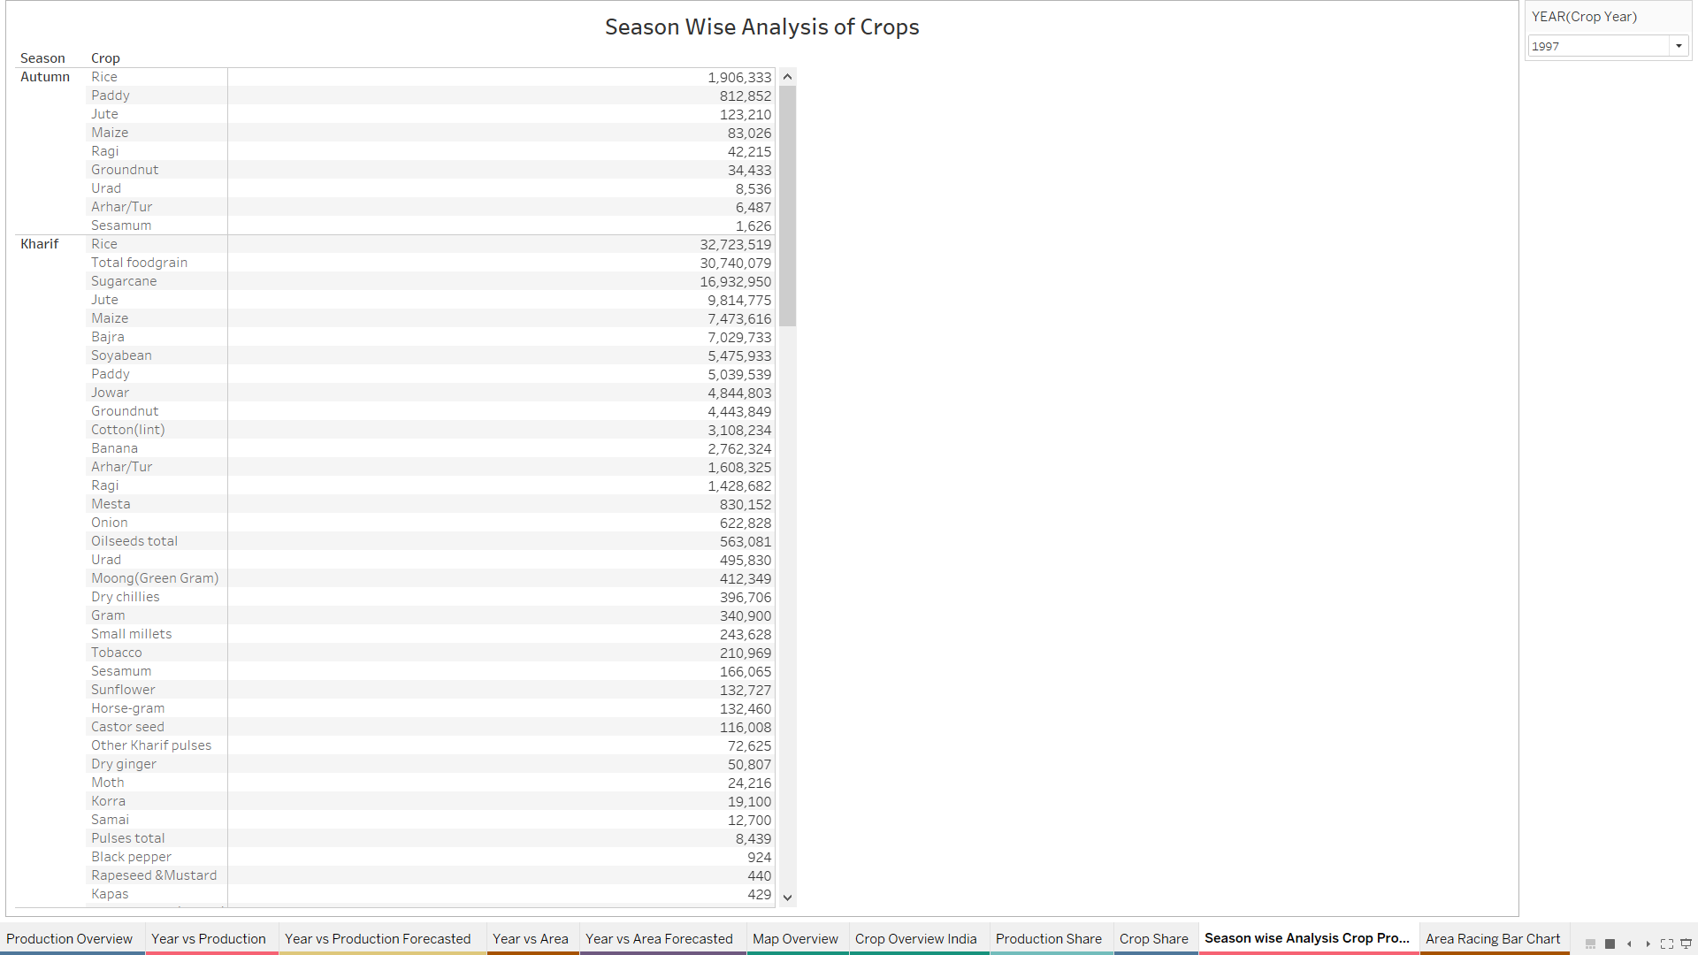
SEASON WISE ANALYSIS OF CROP PRODUCTION
The following text tables indicates the Crop Production for each of the Season.
There mainly Autumn, Kharif, Rabi, Summer, Winter, Whole Year as Seasons in the table.
We can change the year using the filter available in the Worksheet.

Slide 15
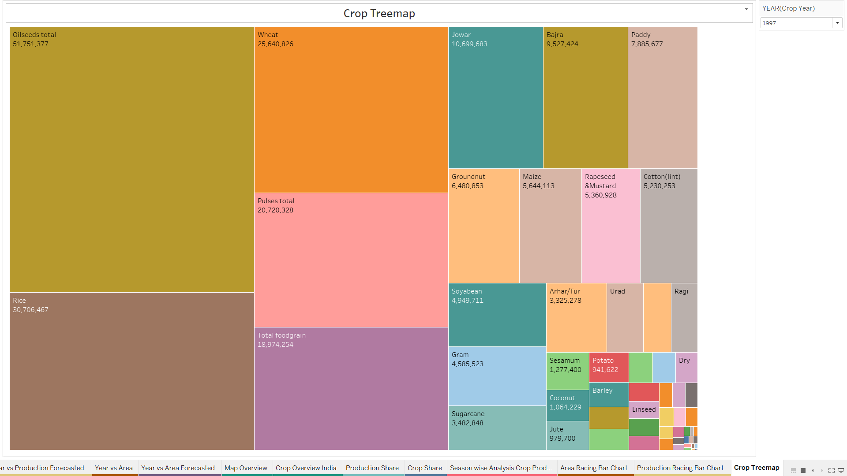
CROPS TREEMAP
The treemap indicates the highest Crop production for each year.
This is easy for Business experts to get an overview of the production.

Slide 16
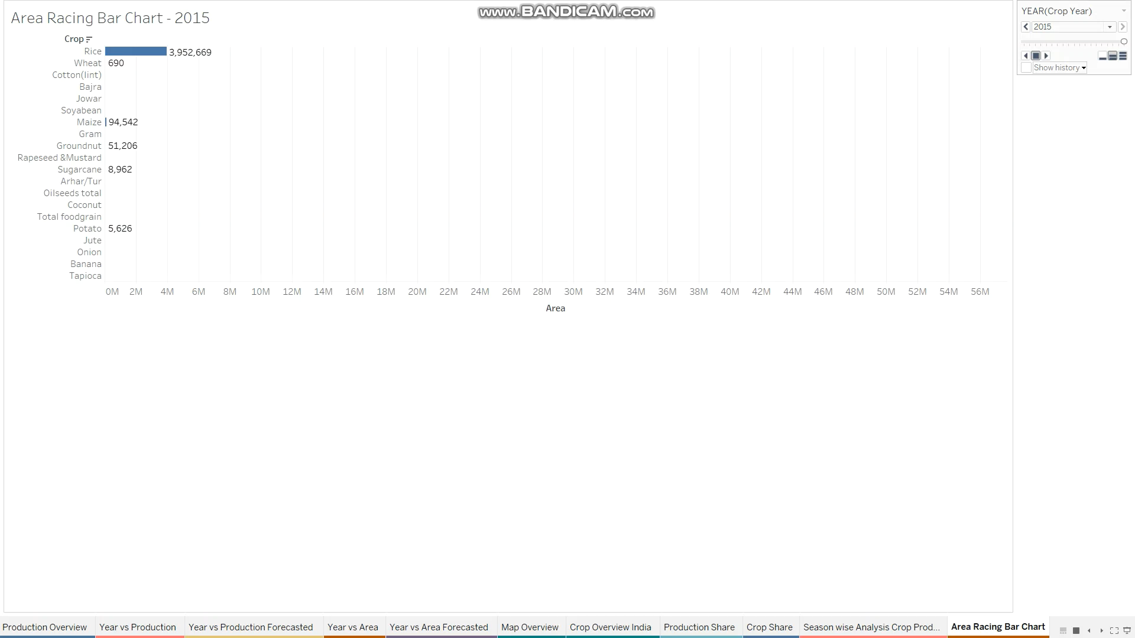
AREA RACING BAR CHART

Slide 17
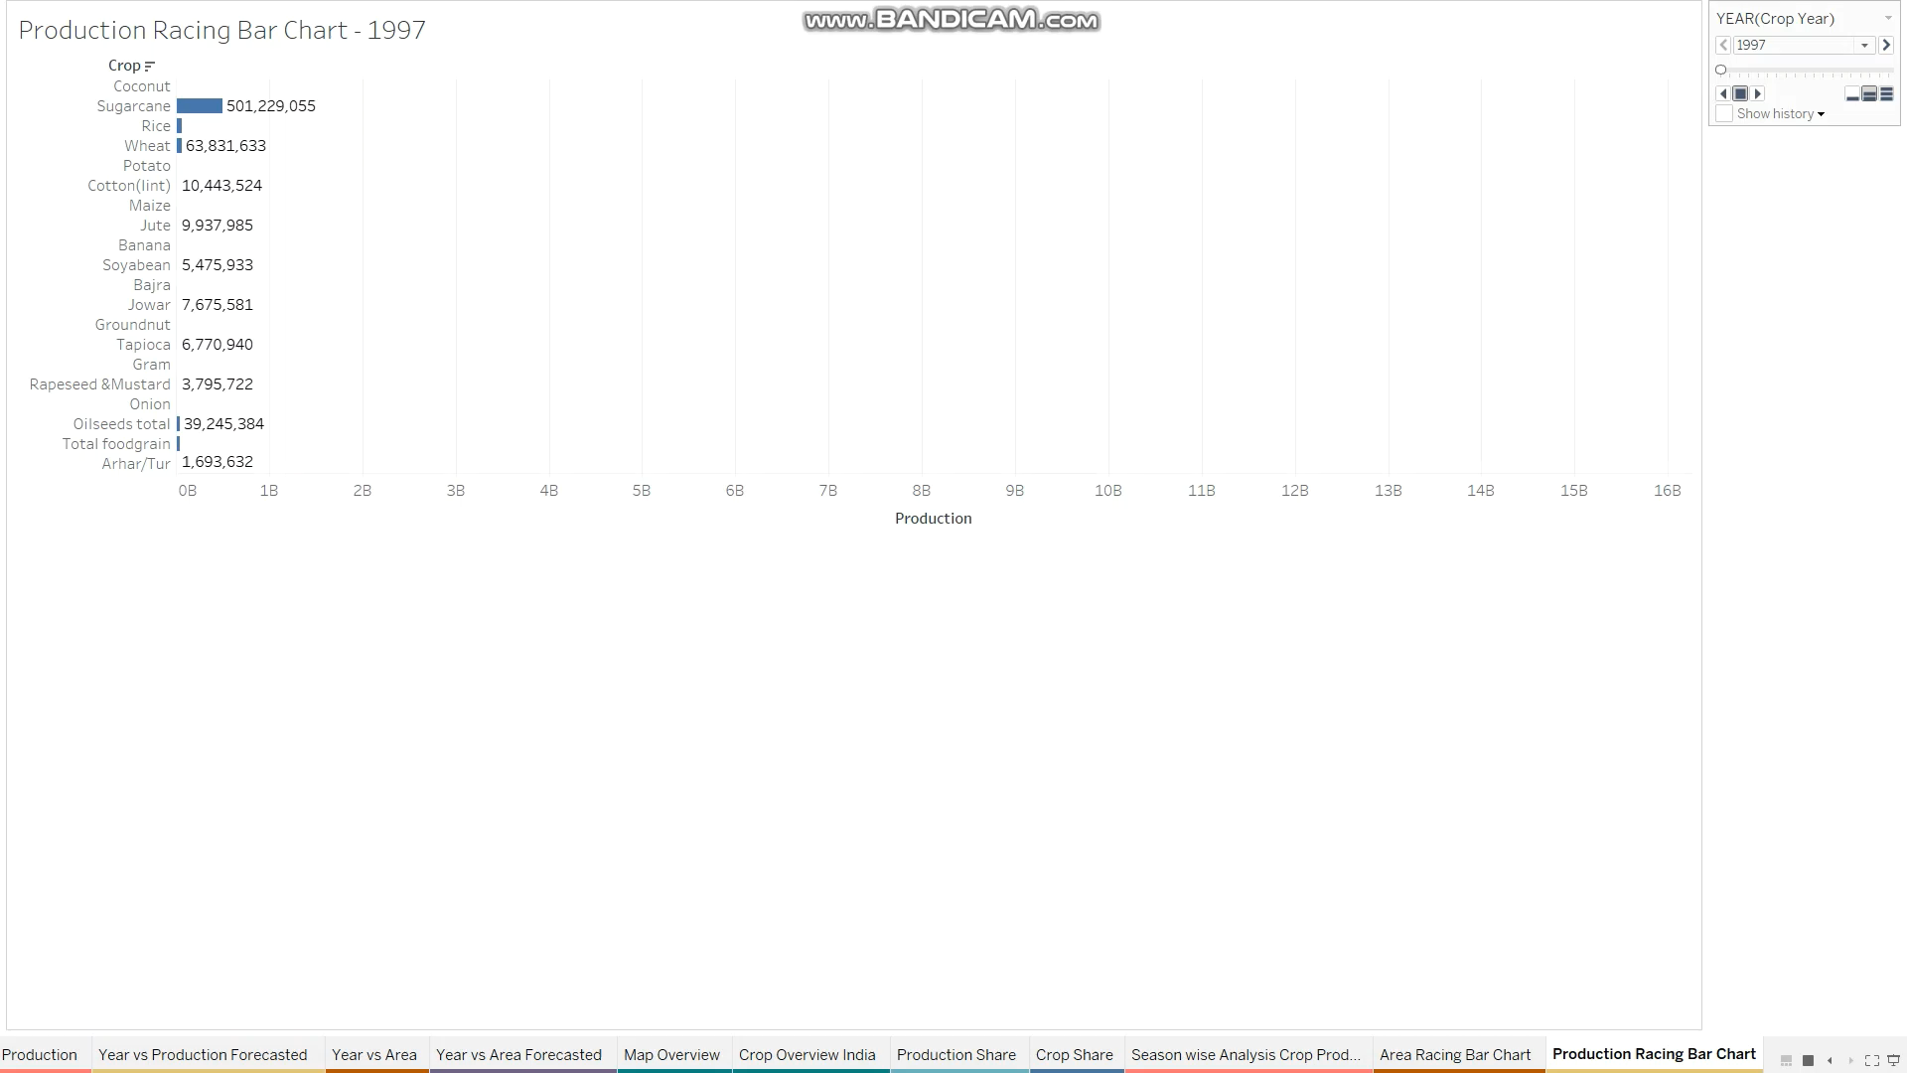
PRODUCTION RACING BAR CHART

Slide 18
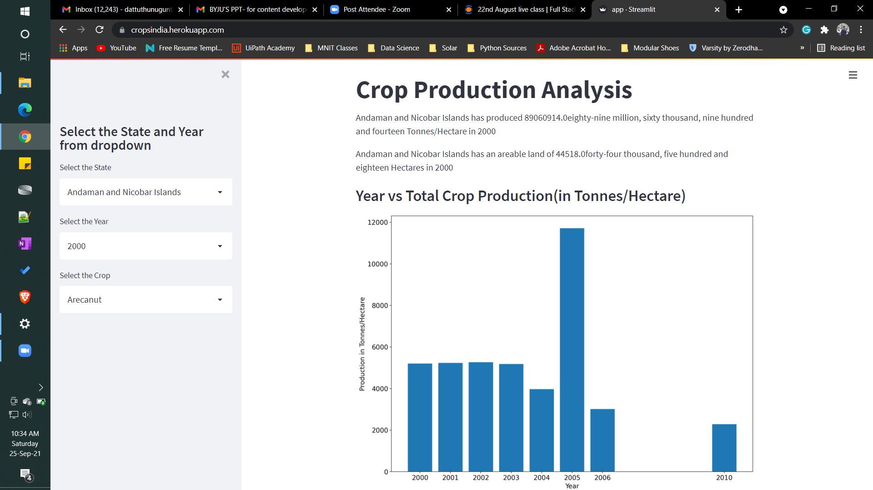
HEROKU DEPLOYMENT
The Streamlit based app.py file has been deployed in the Heroku.
One can get the results of any state for different year & different crop
Heroku Webapp Link: https://cropsindia.herokuapp.com/

Slide 19
IMPORTANT LINKS
Heroku Webapp: https://cropsindia.herokuapp.com/
GitHub repository: https://github.com/dattu-98/crops_india
Tableau reports: https://github.com/dattu-98/crops_india/tree/master/tableau_reports
Documents: https://github.com/dattu-98/crops_india/tree/master/Documents

Slide 20
Q & A
What's the Source of the Data - Collected from Given Data Set
What was the type of Data - Numerical and Categorical Values
What is the flow of the project - According to the Architecture mentioned above
How did you deploy the report – Tableau Online is necessary to deploy the report which is an enterprise version. I had deployed few important statistics using Heroku with Streamlit framework.
What results did you get - Many important parameters can be obtained from the worksheets available in the report & also the deployed Heroku webapp.

